Slide 1
Customer Roadmap -
FUJITSU Desktop ESPRIMO
August 2016

Slide 2
ESPRIMO Desktop Positioning 2015/16
Benefits
Superior Line
Advanced Line
High performance, transparent
computing, flexible integration
into complex infrastructures
ESPRIMO P956
ESPRIMO P956/LL
ESPRIMO D956
ESPRIMO D956/LL
ESPRIMO Q956
ESPRIMO X956/T
ESPRIMO X956
All-round Line
Complex applications,
e.g. table calculation, documents,
presentations, databases, video,
standard manageability
ESPRIMO P756
ESPRIMO D756
Standard applications,
e.g. Internet, e-mail, office applications
ESPRIMO P556
ESPRIMO D556
ESPRIMO Q556
ESPRIMO A525-L
Functionality

Slide 3

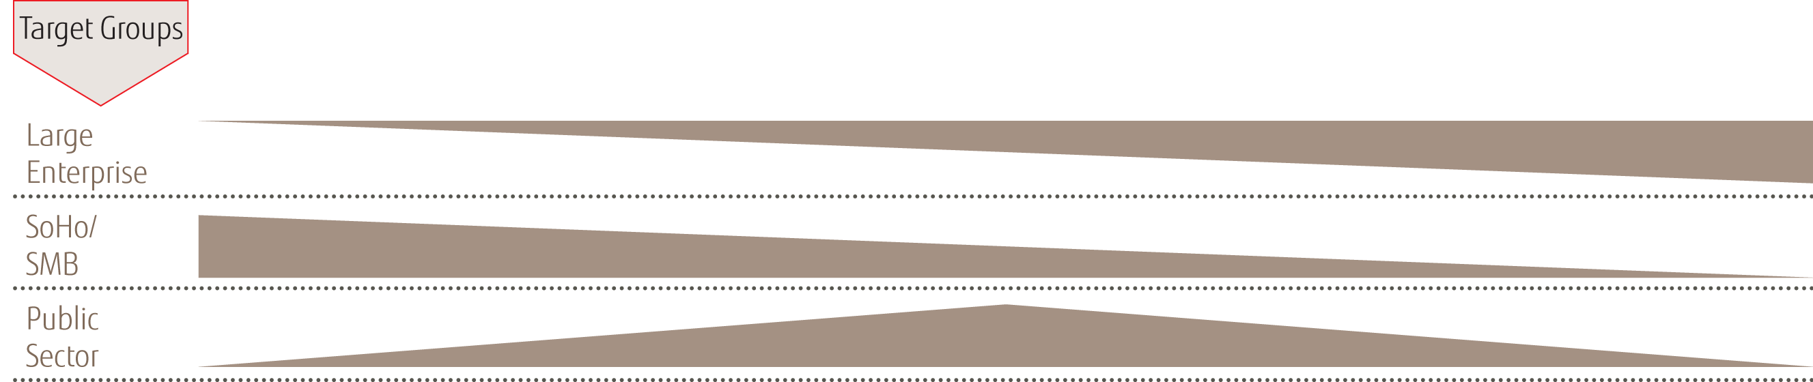
Segmentation of ESPRIMO PCs
SUPERIOR LINE
ADVANCED LINE
High Performance, Manageable Computing
ALL-ROUND-LINE
Complex applications
Enterprise manageability
with the DeskView suite &
Intel vPro™ technology
Long lifecycle option
Highest energy efficiency with
sophisticated power supply
Zero Noise PC
Standard applications
Advanced Manageability with the
DeskView suite & Intel Standard
Manageability
Managed lifecycle of up to 18 months
Power supplies up to 94% efficiency
Low Power Active Mode supports
instant communication in the office
Easy serviceability
Manageability with the DeskView suite
Excellent price to performance ratio
Easy serviceability
Immediately available via channel
partners

Slide 4
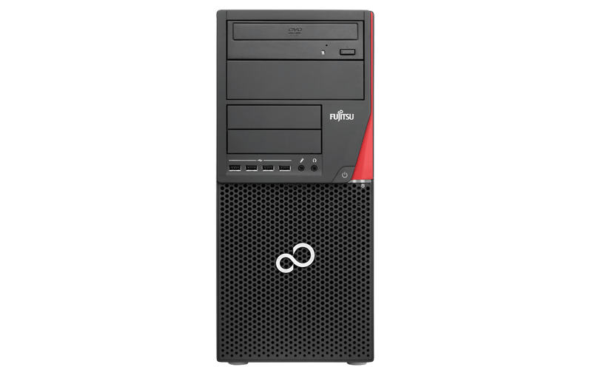
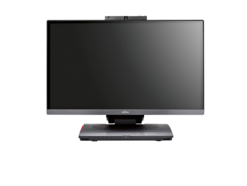
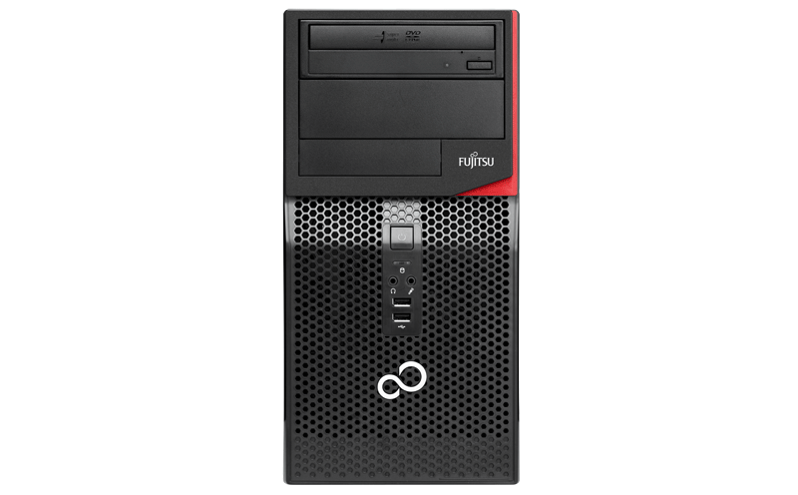
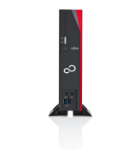
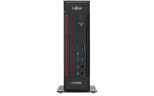
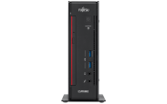
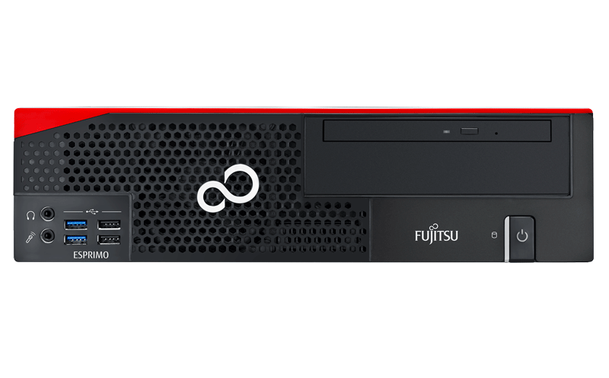

Portfolio ESPRIMO Desktops 2015/16
ALL-ROUND LINE
ADVANCED LINE
SUPERIOR LINE
Standard Applications
Complex Applications
High Performance, Manageable Computing
Q556
A525-L
D556 / P556
D756 / P756
Q956
X956 / X956/T
D956/LL / P956/LL
D956 / P956
Mini PC (~2 liters)
Compact design for
a tidy desk
Manageability with
the DeskView suite
Lowest noise and
energy consumption
Highly-efficient, integrated power supply
Low Power Active Mode supports
instant communication in the office
Thin PC
Compact design for
a tidy desk
Highly-efficient power supply reduces the energy bill
Fanless cooling for increased productivity
Lifecycle up to 24 months
Small form factor / Microtower
Manageability with
the DeskView suite
Excellent price / performance ratio
Easy serviceability
Small form factor / Microtower
Advanced Manageability with the
DeskView suite & Intel Standard
Manageability
Managed lifecycle of up to 18 months
Power supplies up to 94% efficiency
Low Power Active Mode supports
instant communication in the office
Easy serviceability
Mini PC (~2 liters)
Compact design for a
tidy desk
Enterprise manageability
with the DeskView suite & Intel vPro™ technology
Highly-efficient, integrated power supply
Lowest noise and
energy consumption
Low Power Active Mode supports
instant communication in the office
Integrated VESA mounting
All-in-one
Enterprise manageability
with the DeskView suite & Intel vPro™ technology
Highly-efficient, integrated power supply
Lowest noise and
energy consumption
Touch option
Integrated multimedia module (option)
Low Power Active Mode supports
instant communication in the office
Small form factor / Microtower
Lifecycle up to
24 months
Enterprise manageability
with the DeskView suite & Intel vPro™ technology
Highest energy efficiency with
sophisticated power supply
Low Power Active Mode supports
instant communication in the office
Easy serviceability
Small form factor / Microtower
Enterprise manageability
with the DeskView suite & Intel vPro™ technology
Highest energy efficiency with
sophisticated power supply
Low Power Active Mode supports
instant
communication
in the office
Zero Noise PC
Easy serviceability

Slide 5

OVERVIEW Desktop Portfolio – Superior
ESPRIMO Pxxx
ESPRIMO Dxxx
ESPRIMO D/P956 iQ170
ESPRIMO P920 iQ87
ESPRIMO D/P956/LL iQ170
Superior
ESPRIMO C/P910-L iQ77
ESPRIMO Qxxx
ESPRIMO Q956 iQ170
ESPRIMO Q920 iQ87
ESPRIMO X956 / X956/T iQ170
ESPRIMO X923 / X923-T iQ87

Slide 6
OVERVIEW Desktop Portfolio – Advanced
ESPRIMO Pxxx
ESPRIMO Dxxx
ESPRIMO P756 iQ150
Advanced
ESPRIMO D756 iQ150
ESPRIMO P720 iQ85
2016

Slide 7
OVERVIEW Desktop Portfolio – All-round
ESPRIMO Pxxx
ESPRIMO P520 iB85
ESPRIMO Dxxx
ESPRIMO P556 / PH556 iH110
ESPRIMO D556 iH110
All-round
ESPRIMO P420, PH320 iH81
ESPRIMO Qxxx
ESPRIMO Q556 iH110
ESPRIMO A525-L
2016

