Slide 1
Roadmap Displays
September 2016

Slide 2
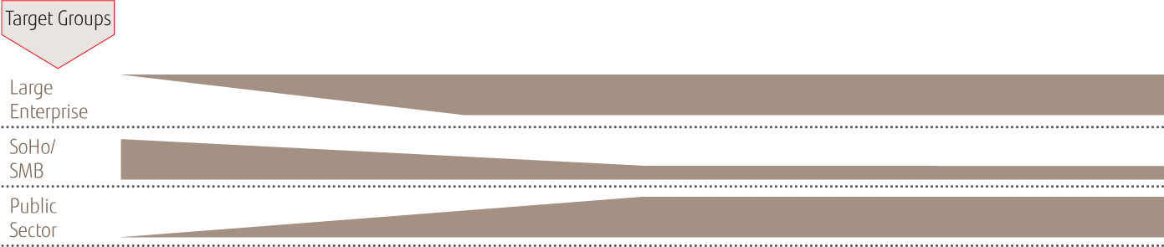
Segmentation of FUJITSU Displays
SUPERIOR LINE
ADVANCED LINE
Future-oriented power pack
ALL-ROUND-LINE
Permanent office use
Managed lifecycle (typical 24 months)
Premium picture performance by individual calibrated screens
Outstanding workplace ergonomics
Best usability with sensor support
Cutting-edge connectivity
Pioneering energy-efficiency
Designed to 24/7 use
Remote administration support
Common office use
Managed lifecycle (typical 24 months)
Outstanding workplace convenience
Steady highest level visual ergonomics
Flexible connectivity
Extremely energy-efficient
Proved to 24/7 use
Remote administration support
Managed lifecycle (typical 18 months)
All-out picture quality
Ergonomic features suitable for TCO
Multi-connectivity
Energy saving
Audio support

Slide 3
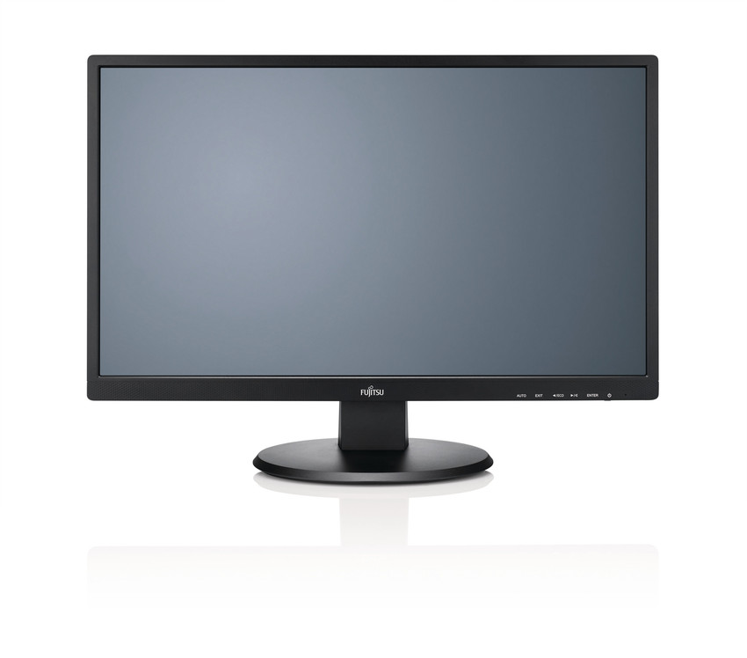
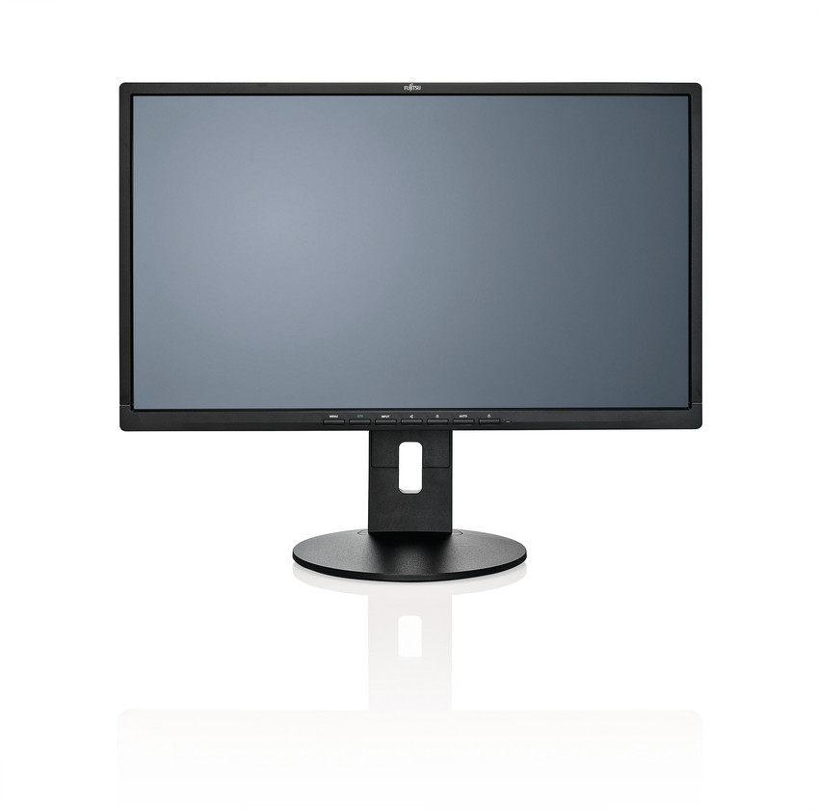
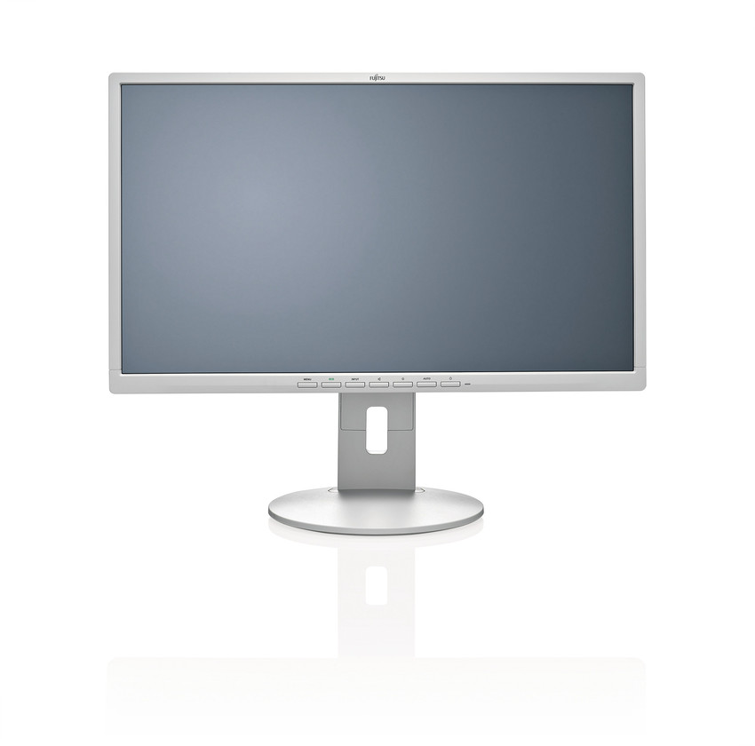
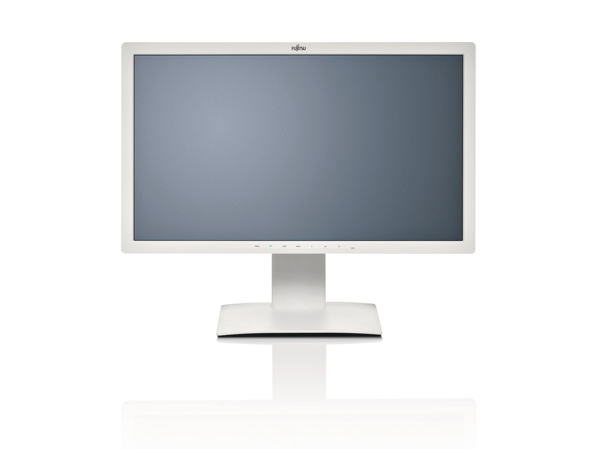
Portfolio Roadmap Displays
ALL-ROUND
ADVANCED
SUPERIOR
Energy Saving
Ergonomic
Performance
E Line
B Line
P Line
Housing: Matt black
Stand base:
Tilt ≥ 20°, detachable
VESA mount 100 mm
Interfaces:
DVI (HDCP), VGA, HDMI*
Energy Management:
ECO operation mode
Audio:
Built-in speaker
Headphone connector
Touch Screen*
10-finger PCT
Anti-glare
Housing: Ergonomic grey or matt black*
Stand base:
Tilt 35°*, detachable
Height adjust 150 mm*
Swivel ≤ 340°
Height over desk 40 mm*
Pivot support
Panel: Wide viewing angle technology*
Interfaces:
Display Port* or HDMI*, DVI-D (HDCP), VGA
USB 2.0 hub*
Energy management:
ECO operation mode
LED mode indicator
Manageability: ‘DisplayView’
24/7 approved
Housing: Ergonomic grey
Stand base: Same as B Line
Panel: Wide viewing angle performance
High resolution up to UHD
DICOM compatible mode
Sensors:
Presence Sensor*
Auto Pivot
Auto Brightness*
UC&C: Call and Status Indicator*
Interfaces:
DisplayPort, HDMI, DVI-D*, VGA*
USB 3.0 hub
Energy management: Same as B Line
0 –Watt in power save mode*
Manageability: ‘DisplayView’
24/7 approved
* Featured on selected models

Slide 4





Product Overview Superior
P Line
P27T-7 UHD, IPS, LED, marble grey
27”, USB 3.0, 1x DP, 1x mini DP, 1x HDMI 2.0, 2x HDMI/MHL
Successor
Target customer and applications
Large Accounts, public sector, ergonomic enthusiasts
Highly demanding graphic applications
Medical review (DICOM)
Process observation including 24/7 use
Benefits
Premium picture performance and resolutions
Outstanding workplace ergonomics
Trend-setting usability by sensors assistance
ABC – Automatic Brightness Control
Presence sensor*
Auto – Pivot control
Cutting-edge connectivity
Pioneering energy-efficiency
Designed for 24/7 use
Remote administration support
P27T-7 LED, IPS, LED, marble grey
27”,QHD, USB 3.0,DP,HDMI,DVI,VGA, sRGB
P27-8 TS Pro, IPS, LED, black, frameless
27”,QHD, USB 3.0,DP,HDMI,DVI, DP Daisy Chain, Presence sensor
P Line
P24-8 WS Pro, IPS, LED, black, frameless
24”, 1920x1200px,USB3.0,DP,HDMI,DVI, DP Daisy Chain; Presence sensor
P24W-7 LED, IPS, LED, marble grey,
24”, 1920x1200px,USB3.0,DP,HDMI,MHL,DVI,VGA
P24T-7 LED, WVA, LED, marble grey, 24”, 1920x1080px, USB3.0,DP,HDMI,MHL,DVI,VGA, Presence sensor, UC&C
P24-8 TE Pro, IPS, LED, marble grey, narrow frame, 23.8”, 1920x1080px, USB3.0, DP, DVI, VGA, Presence sensor, UC&C
2016
2017
(* featured with selected models)

Slide 5
Product Overview Advanced
B27T-7 LED, 300cd/m², IPS, marble grey 27”, FHD, 1920x1080px, USB, DP, DVI, VGA,
B27T-7 Pro, energy optimized, 250cd/m², IPS, marble grey 27”, FHD, 1920x1080px, USB, DP, DVI, VGA,
B Line
Successor
B24W-7 LED, IPS, LED, marble grey
24”, 16:10 format, 1920x1200px, USB,DP, DVI,VGA
B24-8 TE PRO, IPS, LED, marble grey
23.8”, FHD, 1920x1080px, USB,DP,DVI,VGA
Target customer and applications
Large Accounts, public sector and SME
Long life-cycle requests (24 months +)
Permanent office use
24/7 workplaces
Benefits
Steady highest level visual ergonomics
Outstanding ergonomic convenience
Ageless plain design
Flexible connectivity
Extremely energy-efficient
Proved to 24/7 use
Remote administration support
B24T-7 LED
B24-8 TS PRO, IPS, LED, black
23.8”, FHD, 1920x1080px, USB,HDMI,DVI,VGA
B24T-7 LED proGREEN
B24T-1L LED, black 24”, FHD, 1920x1080px, HDMI,DVI,VGA,
B Line
B23T-7 LED, IPS, marble grey 23”, FHD, 1920x1080px, USB,DP, DVI,VGA
B22W-7 LED, marble grey
22”, 16:10 format,1680x1050px, USB,DP,DVI,VGA
B22-8 TS Pro, black 21.5”, FHD, 1920x1080px, DP,DVI,VGA,
B22T-7 LED proGREEN
B22T-7 PRO, IPS, black, 21.5”, FHD, 1920x1080px, USB, HDMI, DVI, VGA
B20T-7 LED proGREEN, black
19.5”, 1600x900px, DVI, VGA
B19-7 LED, IPS, marble grey
19”, 5:4 format,1280x1024, DVI,VGA
2016
2017

Slide 6


Product Overview All-round
E Line
E24T-7 Pro, IPS, black
23.8”, 16:9 format, FHD, 1920x1080px, HDMI,DVI,VGA
E24-8 TS Pro, IPS, black
23.8”, 16:9 format, FHD, 1920x1080px, DP,DVI,VGA
Target customer and applications
SME, SoHo
Common office use
Use with optional mounting parts
Benefits
All-out picture quality
Ergonomic features suitable TCO
Multi-connectivity
Ready for ‘Backpack’ solutions
Energy saving
Audio support
E22 TOUCH, IPS, black 21.5”, 16:9 format,1920x1080px,4xUSB 3.0,HDMI,DVI,VGA 10-finger PCT touch, non-glossy
Successor in P-Line
E Line
E22T-7 Pro, IPS, black 21.5”, 16:9 format, FHD, 1920x1080px, HDMI,DVI,VGA
E22T-7 LED
E22-8 TS Pro, IPS, black
21.5”, 16:9 format, FHD, 1920x1080px, DP,DVI,VGA
E20T-7, black 19.5” , 16:9 format, 1600x900px, DVI, VGA
E19-7 LED IPS, black 19”, 5:4 format,1280x1024px, DVI, VGA
2016
2016
2017

