Slide 1
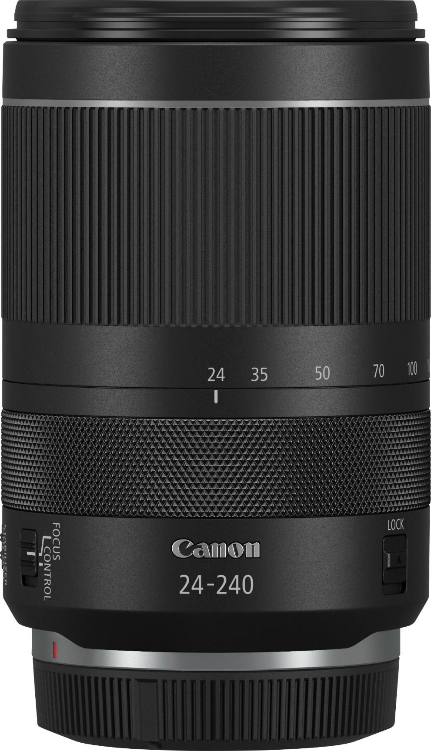
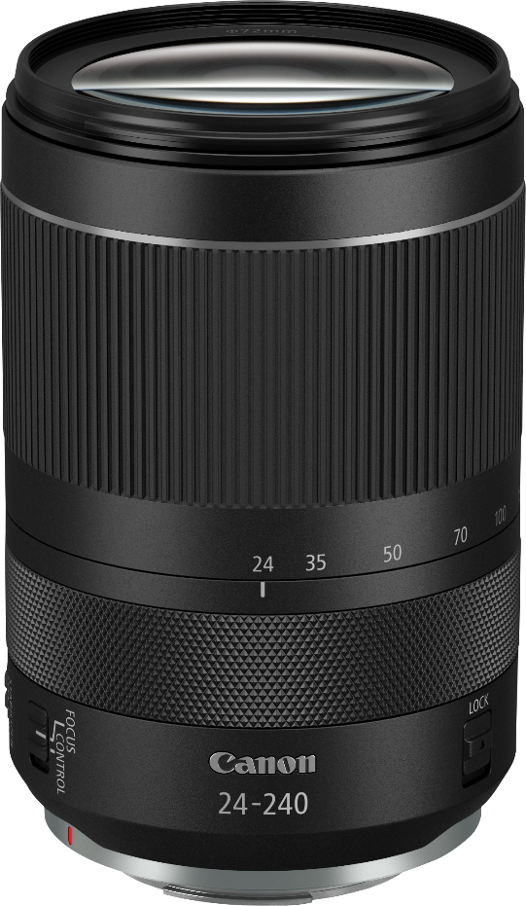
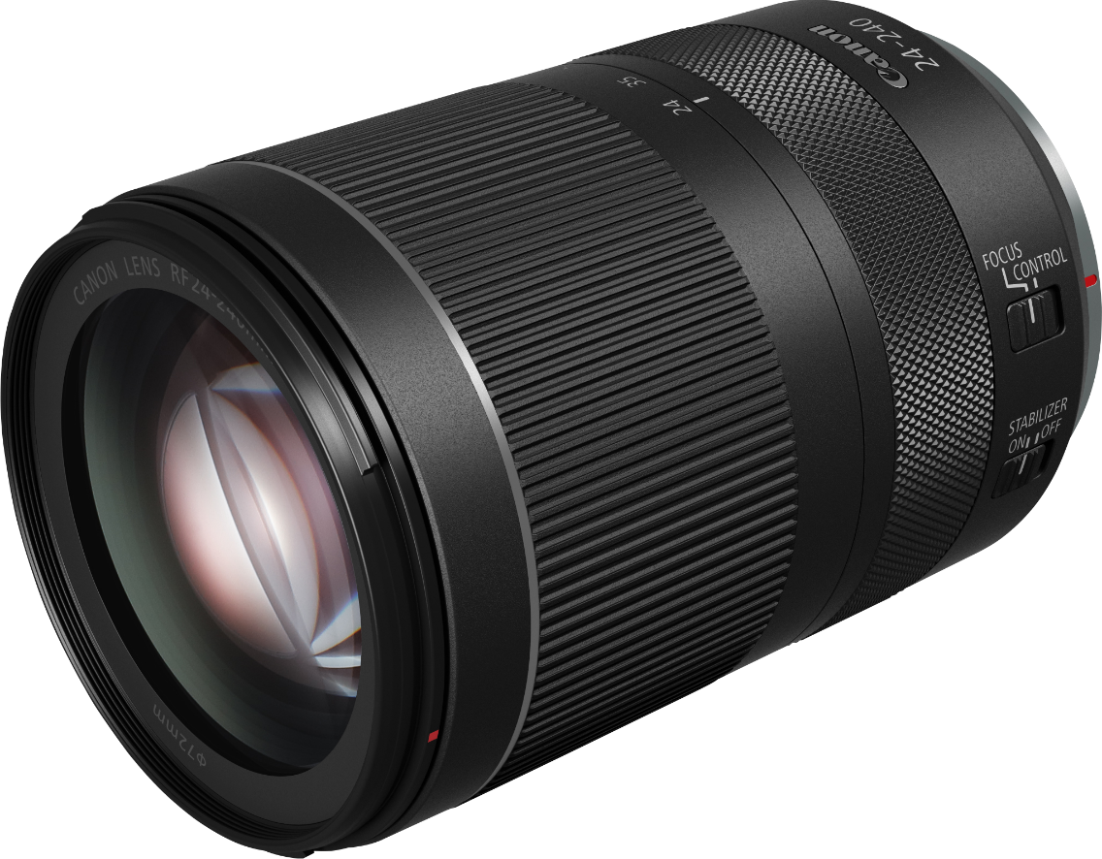
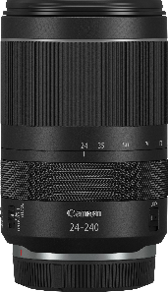
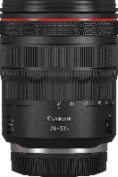
RF 24-240mm F4-6.3 IS USM
ONE LENS, TEN TIMES THE CREATIVITY
This 10x zoom lens for the EOS R system is perfect when you only want to take one lens with you. Enjoy incredible versatility, full-frame image quality and all of the technical advances of the EOS R system. Superb for creative travel images.
Shoot with a single lens
Be mobile and spontaneous
Full-frame image quality
Fast, flexible focusing
A native RF lens
PRODUCT RANGE
RF 24-240mm F4-6.3 IS USM
RF 24-105mm F4L IS USM
RF 24-240mm F4-6.3 IS USM
RF 24-105mm F4L IS USM

Slide 2
TECHNICAL
SPECIFICATIONS
RF 24-240mm F4-6.3 IS USM
OPTICAL FEATURES/ SPECIFICATIONS
Image size | Full Frame
35mm film equivalent focal length (mm) | -
Angle of view at infinity horizontal vertical diagonal | 74° - 8°35', 53° - 5° 45', 84° - 10°20'
Lens construction (elements/groups) | 21/15
No. of diaphragm blades | 7
Minimum aperture | 22-38 (36)
Closest focussing distance (m) | 0.5
Maximum magnification (x) | 0.26
Distance Information | Yes
Image stabilizer | 5 stops
AF actuator | Nano USM
PHYSICAL SPECIFICATIONS
Dust/moisture resistance | No
Filter diameter (mm) | 72
Max. diameter x length (mm) | 80.4 x 122.5
Weight (g) | 750
ACCESSORIES
Lens cap | E-72 II
Lens hood | EW-78F (not bundled)
Lens case/pouch | LP1219 (not bundled)
Rear cap | Lens Dust Cap RF
Extender Compatiblity | Not Compatible
Canon Inc.
canon.com
Canon Europe
canon-europe.com
English edition
Canon Europa NV 2019
Canon Inc.
canon.com
Canon Europe
canon-europe.com
English edition
Canon Europa NV 2019

Slide 3
ONE LENS, TEN TIMES THE CREATIVITY
RF 24-240mm F4-6.3 IS USM
This 10x zoom lens for the EOS R system is perfect when you only want to take one lens with you. Enjoy incredible versatility, full-frame image quality and all of the technical advances of the EOS R system. Superb for creative travel images.
Sales Start Date: September 2019
PRODUCT DETAILS:
Product Name | Mercury Code | EAN Code | Recommended Retail Price
Lens RF 24-240mm F4-6.3 IS USM | 3684C005AA | 4549292151411 | <Please fill in RRP>
ACCESSORY DETAILS:
Product Name | Mercury Code | EAN Code | Recommended Retail Price
Lens Hood EW-78F | 3685C001AA | 4549292151428 | <Please fill in RRP>
Lens Dust Cap RF | 2962C001AA | 4549292115604 | <Please fill in RRP>

Slide 4
ONE LENS, TEN TIMES THE CREATIVITY
RF 24-240mm F4-6.3 IS USM
This 10x zoom lens for the EOS R system is perfect when you only want to take one lens with you. Enjoy incredible versatility, full-frame image quality and all of the technical advances of the EOS R system. Superb for creative travel images.
Measurement / Logistic Information:
Product Name | Mercury Code | Pack type | Pack description | Quantity per pack | Length (cm) | Width (cm) | Height (cm) | Gross Weight (kg)
Lens RF 24-240mm F4-6.3 IS USM | 3684C005AA | EA | Each | 1 | 12.7 | 12.7 | 20.5 | 1.0
 |  | CT | Carton | 6 | 39.5 | 27.2 | 24 | 6.42
 |  | EP | Euro Pallet | TBC | 120 | 80 | TBC | TBC
 |  |  | Layers per Pallet | TBC
 |  |  | Cartons per Layer | TBC
 |  |  | Products per layer | TBC
Lens Hood EW-78F | 3685C001AA | EA | Each | 1 | TBC | TBC | TBC | TBC
 |  | CT | Carton | TBC | TBC | TBC | TBC | TBC
 |  | EP | Euro Pallet | TBC | 120 | 80 | TBC | TBC
 |  |  | Layers per Pallet | TBC
 |  |  | Cartons per Layer | TBC
 |  |  | Products per layer | TBC
What’s in the box?
RF 24-240mm F4-6.3 IS USM
Lens CAP E-72II
Lens Dust Cap RF
User Manual Kit (EUR)

