Slide 1
Priser som er vedlagt er veiledende sluttkundepriser per oktober 2018. Disse kan variere og endres uten forvarsel.
Prisene kan ikke garanteres og vil kunne variere i begge retninger.
Produkter i listen kan fjernes uten forvarsel.
Forhør deg alltid om pris med din nærmeste partner eller kundeansvarlig.
Produktliste med priser

Slide 2
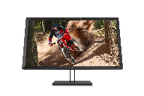
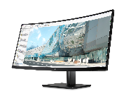
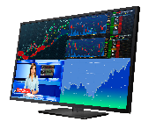



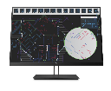


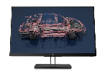
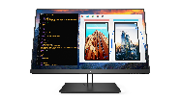

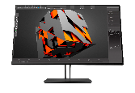
2018 HP Z Displays
Z DISPLAY COMPARISON
 | Z22n G2 | Z23n G2 | Z24nf G2 | Z24i G2 | Z24n G2 | Z24x G2 | Z27n G2 | Z27 | Z27x G2 | Z31x | Z32 | Z38c | Z43
PN Streetprice | 1JS05A4 | 1JS06A4 | 1JS07A4 | 1JS08A4 | 1JS09A4 | 1JR59A4 | 1JS10A4 | 2TB68A4 | D7R00A4 | Z4Y82A4 | 1AA81A4 | Z4W65A4 | 1AA85A4
Screen size (diagonal) | 21.5" | 23" | 23.8" | 24" | 24" | 24" | 27" | 27” | 27" | 31.1" | 31.5” | 37.5“, Curved | 42.5”
Resolution | FHD 1920 x 1080 | FHD 1920 x 1080 | FHD 1920 x 1080 | WUXGA 1920 x 1200 | WUXGA 1920 x 1200 | WUXGA 1920 x 1200 | QHD 2560 x 1440 | 4K 3840 x 2160 | QHD 2560 x 1440 | Cinema 4K 4096 x 2160 | 4K 3840 x 2160 | UWQHD 3840 x 1600 | 4K 3840 x 2160
Aspect Ratio | 16:9 | 16:9 | 16:9 | 16:10 | 16:10 | 16:10 | 16:9 | 16:9 | 16:9 | 17:9 | 16:9 | 21:9 | 16:9
Panel | IPS, Flicker Free, 3-Sided micro-edge | IPS, Flicker Free, 3-Sided micro-edge | IPS, Flicker Free, 3-Sided micro-edge | IPS, Flicker Free, 3-Sided micro-edge | IPS, Flicker Free, 3-Sided micro-edge | IPS, Flicker Free | IPS, Flicker Free, 3-Sided micro-edge | IPS, Flicker Free, 3-Sided micro-edge | IPS, Flicker Free | IPS, Flicker Free | IPS, Flicker Free, 4-Sided micro-edge | IPS, Flicker Free, 3-Sided micro-edge | IPS, Flicker Free, 3-Sided micro-edge
Connectivity | DisplayPort™ HDMI VGA USB 3.0 | DisplayPort™ HDMI VGA USB 3.0 | DisplayPort™ HDMI VGA USB 3.0 | DisplayPort™ HDMI VGA USB 3.0 | USB-C™ DisplayPort™ HDMI DVI-D USB 3.0 | DisplayPort™ HDMI USB 3.0 | USB-C™ DisplayPort™ HDMI DVI-D USB 3.0 | USB-C™ DisplayPort™ Mini DisplayPort™ HDMI USB 3.0 | USB-C™ DisplayPort™ HDMI USB 3.0 DreamColor Ports RJ-45 | USB-C™ DisplayPort™ HDMI USB 3.0 DreamColor Ports RJ-45 | USB-C™ DisplayPort™ Mini DisplayPort™ HDMI USB 3.0 | USB-C™ DisplayPort™ HDMI USB 3.0 | USB-C™ DisplayPort™ Mini DisplayPort™ HDMI USB 3.0
USB-C™ | - | - | - | - | Rear: 15W PD², DP™ over USB-C™ Side: 10W PD² | - | Rear: 15W PD², DP™ over USB-C™ Side: 10W PD² | Rear: 65W PD², DP™ over USB-C™ Side: 15W PD² | Rear: 15W PD², DP™ over USB-C™ | Rear: 60W PD², DP™ over USB-C™ | Rear: 65W PD², DP™ over USB-C™ Side: 15W PD² | Side: 65W PD², DP™ over USB-C™ | Rear: 65W PD², DP™ over USB-C™ Side: 15W PD²
Ergonomics | Height, tilt, swivel, pivot | Height, tilt, swivel, pivot | Height, tilt, swivel, pivot | Height, tilt, swivel, pivot | Height, tilt, swivel, pivot | Height, tilt, swivel, pivot | Height, tilt, swivel, pivot | Height, tilt, swivel, pivot | Height, tilt, swivel, pivot | Height, tilt, swivel, pivot | Height, tilt, swivel | Height, tilt, swivel | Tilt, swivel
Features | ZBD Guarantee³, Factory Color Calibration | ZBD Guarantee³, Factory Color Calibration | ZBD Guarantee³, Factory Color Calibration | ZBD Guarantee³, Factory Color Calibration | ZBD Guarantee³, Factory Color Calibration, Daisy Chain, PiP/PbP | ZBD Guarantee³, Factory Color Calibration, Daisy Chain, PiP/PbP | ZBD Guarantee³, Factory Color Calibration, Daisy Chain, PiP/PbP | ZBD Guarantee³, Factory Color Calibration, PiP/PbP | ZBD Guarantee³, Factory Color Calibration, KVM Switch, User Calibration, Integrated Colorimeter, PiP/PbP | ZBD Guarantee³, Factory Color Calibration, KVM Switch, User Calibration, Integrated Colorimeter, PiP/PbP | ZBD Guarantee³, Factory Color Calibration, PiP/PbP | ZBD Guarantee³, Factory Color Calibration | ZBD Guarantee³ 4 source PiP/PbP
DreamColor | - | - | - | - | - | DreamColor | - | - | DreamColor Studio | DreamColor Studio | - | - | -
Mounting Bracket | HP B300 PC Mounting Bracket 2DW53AA | HP B300 PC Mounting Bracket 2DW53AA | HP B300 PC Mounting Bracket 2DW53AA | HP B300 PC Mounting Bracket 2DW53AA | HP B300 PC Mounting Bracket 2DW53AA | HP B300 PC Mounting Bracket 2DW53AA | HP B300 PC Mounting Bracket 2DW53AA | HP B300 PC Mounting Bracket 2DW53AA | HP B500 PC Mounting Bracket 2DW52AA | HP B500 PC Mounting Bracket 2DW52AA | HP B500 PC Mounting Bracket 2DW52AA | HP B500 PC Mounting Bracket 2DW52AA | HP B500 PC Mounting Bracket 2DW52AA
Notes:
¹ Additional displays required and sold separately.
² See Product QuickSpecs for exact specifications.
³ HP ZBD Guarantee. The HP Pixel Policy allows no bright sub-pixel defects for this display. For complete details, see http://support.hp.com/us-en/document/c00288895
DisplayPort™ and the DisplayPort™ logo are trademarks owned by the Video Electronics Standards Association (VESA®) in the United States and other countries.
USB Type-C™ and USB-C™ are trademarks of USB Implementers Forum.

Slide 3
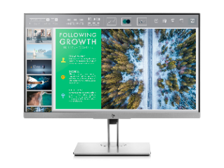
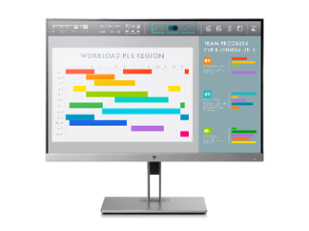
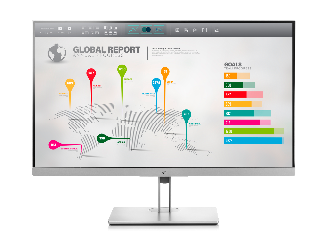
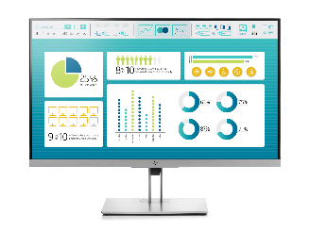
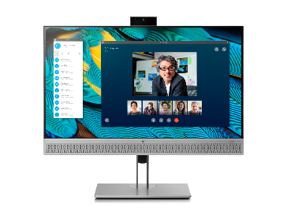
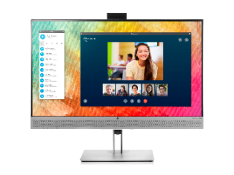
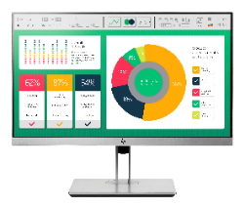
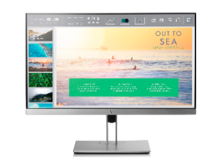

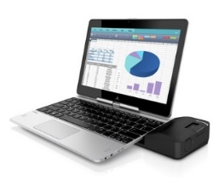
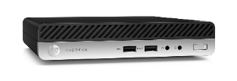
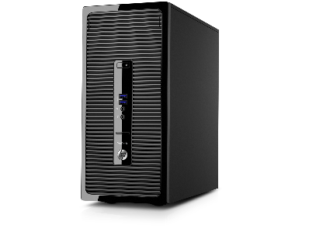
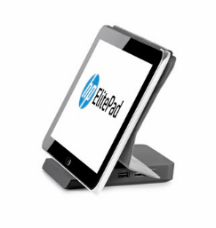
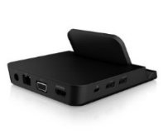
ELITEDISPLAY PORTFOLIO
 | E223 | E233 | E243 | E243i | E273 | E273q | E243m | E273m
PN Streetprice | 1FH45AA | 1FH46AA | 1FH47AA | 1FH49AA | 1FH50AA | 1FH52AA | 1FH48AA | 1FH51AA
Size | 21.5-inch FHD | 23-inch FHD | 23.8-inch FHD | 24-inch WUXGA | 27-inch FHD | 27-inch QHD | 23.8-inch FHD | 27-inch FHD
Resolution | 1920 x 1080 | 1920 x 1080 | 1920 x 1080 | 1920 x 1200 | 1920 x 1080 | 2560 x 1440 | 1920 x 1080 | 1920 x 1080
Panel | IPS, 3-sided micro-edge | IPS, 3-sided micro-edge | IPS, 3-sided micro-edge | IPS, 3-sided micro-edge | IPS, 3-sided micro-edge | IPS, 3-sided micro-edge | IPS, 3-sided micro-edge | IPS, 3-sided micro-edge
Brightness | 250nits | 250nits | 250nits | 300nits | 250nits | 350nits | 250nits | 250nits
Contrast ratio | 1000:1 | 1000:1 | 1000:1 | 1000:1 | 1000:1 | 1000:1 | 1000:1 | 1000:1
Panel Features | Flicker free & low blue light* | Flicker free & low blue light* | Flicker free & low blue light* | Flicker free & low blue light* | Flicker free & low blue light* | Flicker free & low blue light* | Flicker free & low blue light* | Flicker free & low blue light*
Webcam | No | No | No | No | No | No | Yes, Skype for Business® certified | Yes, Skype for Business® certified
Input | VGA, DisplayPort™, HDMI | VGA, DisplayPort™, HDMI | VGA, DisplayPort™, HDMI | VGA, DisplayPort™, HDMI | VGA, DisplayPort™, HDMI | VGA, DisplayPort™, HDMI, and USB-C™⁷ | VGA, DisplayPort™, HDMI | VGA, DisplayPort™, HDMI, and USB-C™⁷
USB Hub | Side - 2 Port 3.0 | Side - 2 Port 3.0 | Side - 2 Port 3.0 | Side - 2 Port 3.0 | Side - 2 Port 3.0 | Side - 2 Port 3.0 | Side - 2 Port 3.0 | Side - 2 Port 3.0
Column Stand | Height adjust, tilt, swivel, pivot | Height adjust, tilt, swivel, pivot | Height adjust, tilt, swivel, pivot | Height adjust, tilt, swivel, pivot | Height adjust, tilt, swivel, pivot | Height adjust, tilt, swivel, pivot | Height adjust, tilt, swivel, pivot | Height adjust, tilt, swivel, pivot

Slide 4
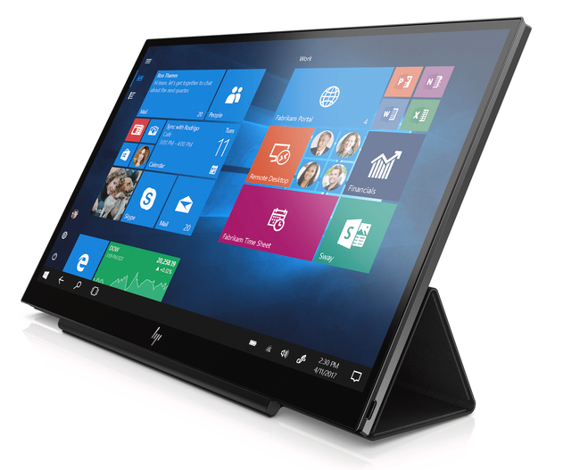
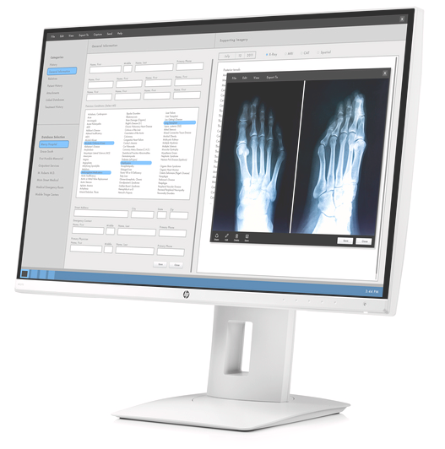
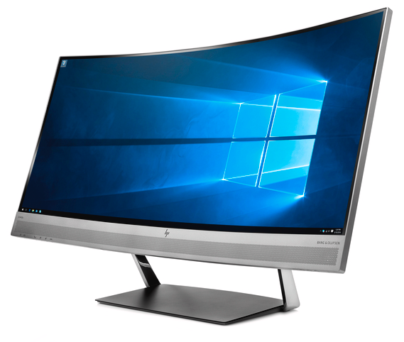
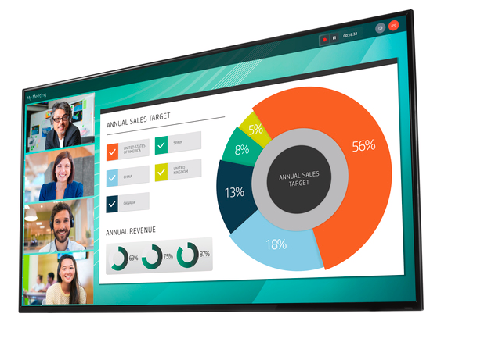
ELITEDISPLAY AND SPECIAL DISPLAYS
 | S14 | HC240 | HC270 | S340c | LFD
PN | 3HX46AA | Z0A71A4 | Z0A73A4 | V4G46AA | 2YD85AA
Size | 14’’ | 24’’ | 27’’ | 34’’ | 55’’
Resolution | 1920x1080 | 1920x1200 | 2560x1440 | 3440x1440 | 3840x2160 (4K)
Panel | IPS | IPS | IPS | IPS | ADS
Brightness | 200nits | 300nits | 350nits | 300nits | 350nits
Contrast ratio | 700:1 | 1000:1 | 1000:1 | 3000:1 | 1200:1
Panel Features |  | Antiglare, | Antiglare, | Antiglare, integrated speaker | Integrated speaker, antiglare, anti static
Webcam |  | N/A | N/A | Integrated | N/A
Input | 1 x USB-C 3 | DVI-D. DP i/O, Mini-DP (HDCP) | DVI-D. DP i/O, Mini-DP (HDCP), MHL/HDMI | DP, HDMI (HDCP) | VGA, HDMI (2.0, 1.4) DP (HDCP)
USB Hub | N/A | N/A | N/A | DP (60W) | N/A
Column Stand | N/A | HP PC Mount N6N00AA | HP PC Mount N6N00AA | Integrert

