Slide 1
Easy Rack and PDU promo

Slide 2
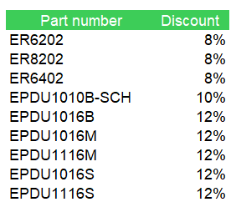
Easy Rack and PDU promo Sep-Oct 2021

